Slide 1
5.1 Installation of rotation angle sensor (four-wheel drive)

Slide 2
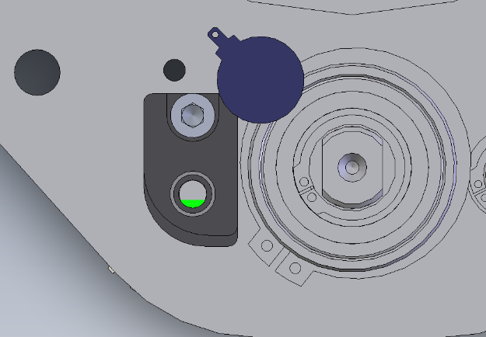
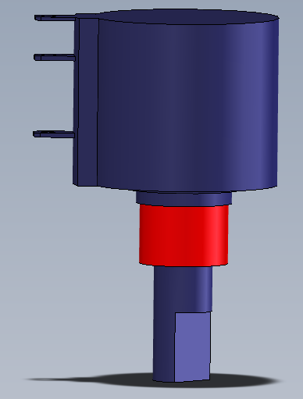
The wheel must be exactly in a straight line
The feather key must then have this alignment
Attention! Rotation angle sensor shaft mounted in the middle position (can be rotated 2.5 revolutions in any direction)!
Flattening must match the feather key

Slide 3
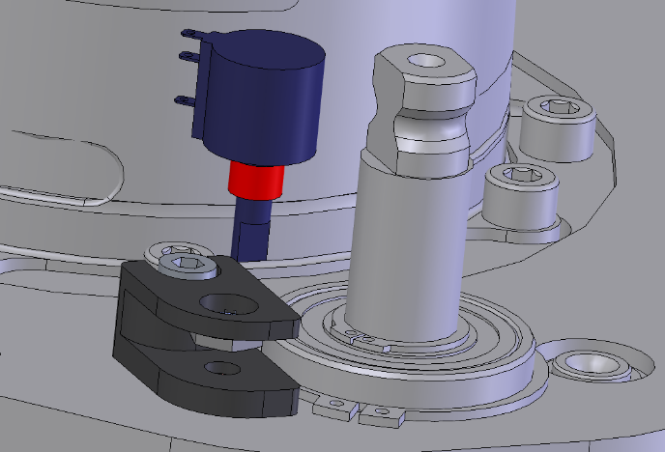
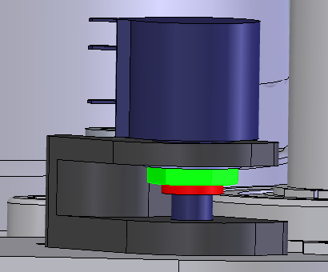
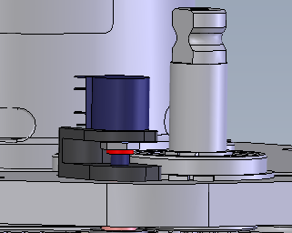
Place the rotary potentiometer on the sensor holder and screw it together
Completely assembled rotation angle sensor

Slide 4
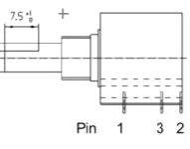
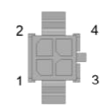
To check correct installation, check the resistance values of the rotation angle sensor:
A resistance of 2.5 ohms must be measurable between PIN1 and PIN2, as well as PIN3 and PIN2

